Slide 1
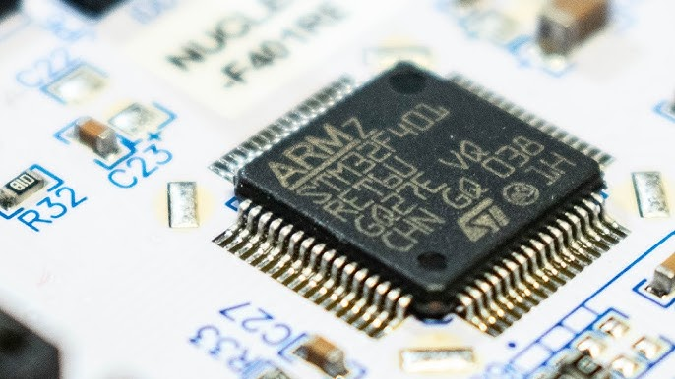
Design With Microprocessors C1

Slide 2
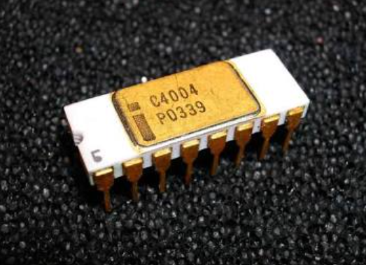
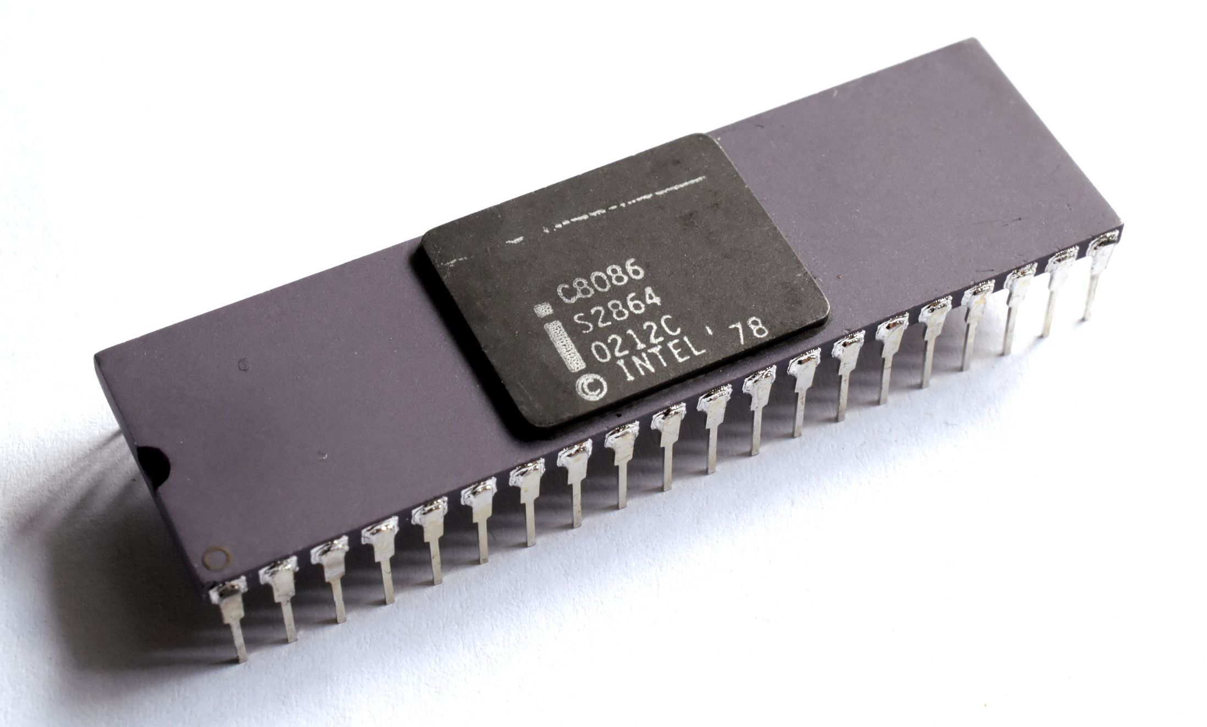
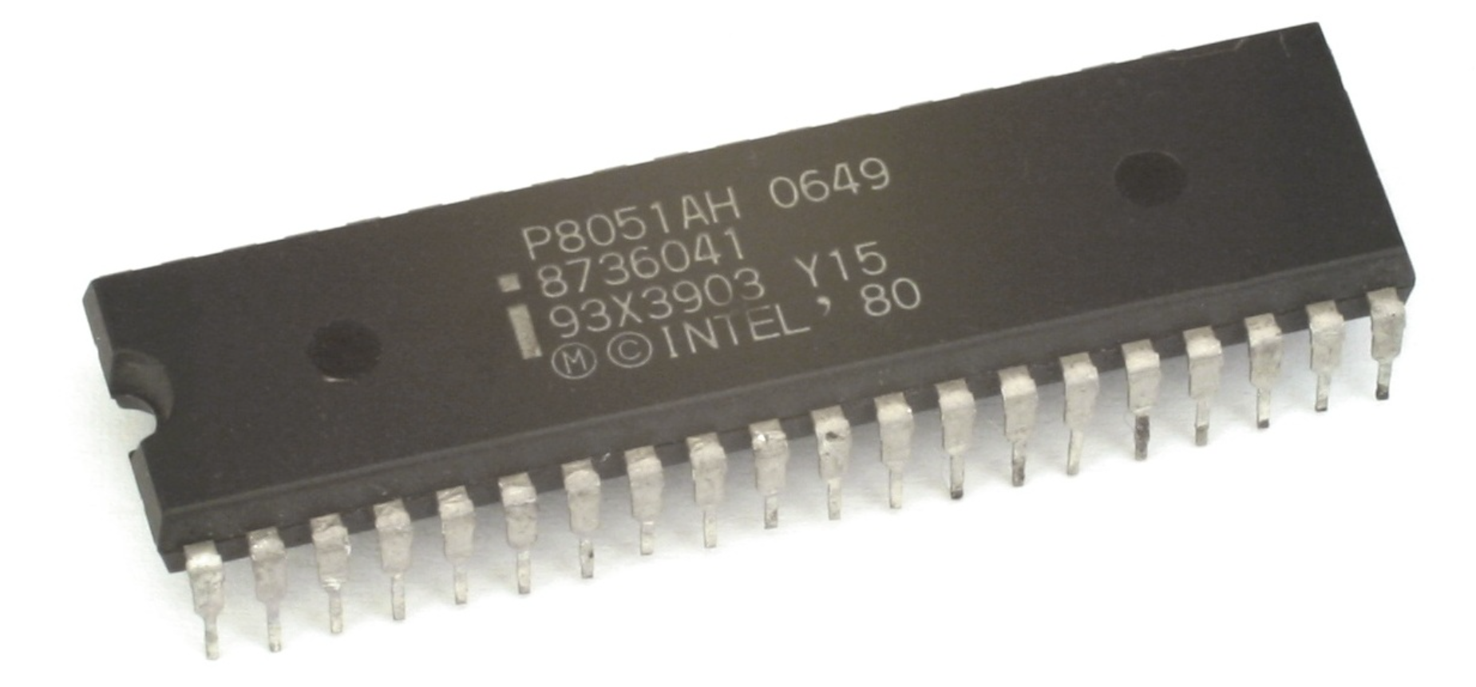
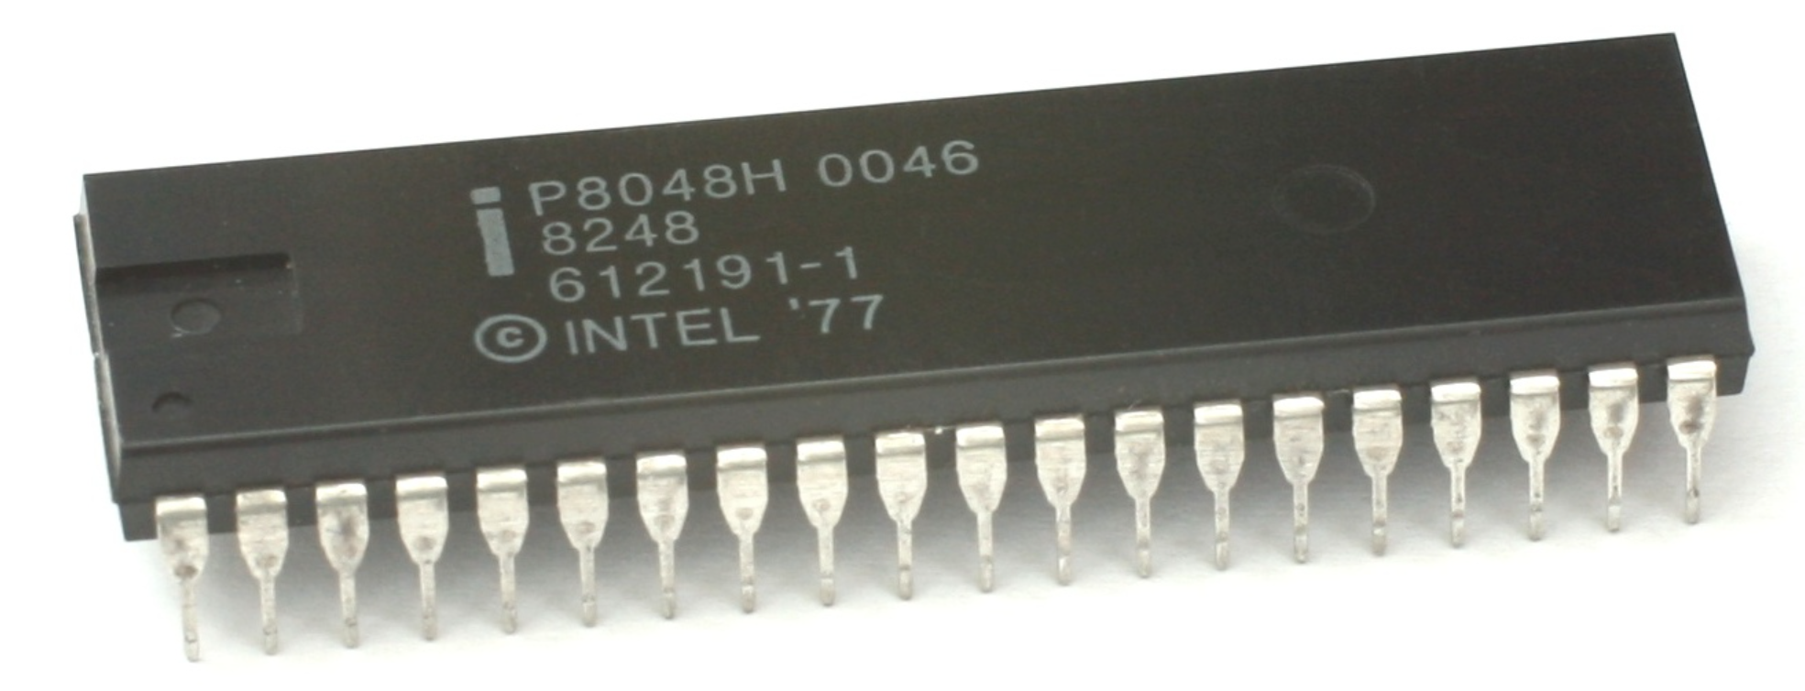
Design With Microprocessors C1
The Intel 4004, released in November 1971, is widely recognized as
the first commercially available, single-chip microprocessor.
The Intel 8086, released in 1978, was the first 16-bit microprocessor and the foundational chip of Intel's x86 architecture, which powers most modern personal computers.
The MCS-48 microcontroller series, Intel's first microcontroller, was originally released in 1976. Its first members were 8048, 8035 and 8748.
The Intel MCS-51 (commonly termed 8051) is a single-chip microcontroller (MCU) series developed by Intel in 1980 for use in embedded systems.
The 8052 was an enhanced version of the original 8051 that featured 256 bytes of internal RAM instead of 128 bytes, 8 KB of ROM instead of 4 KB, and a third 16-bit timer.
Source: Wikipedia

Slide 3
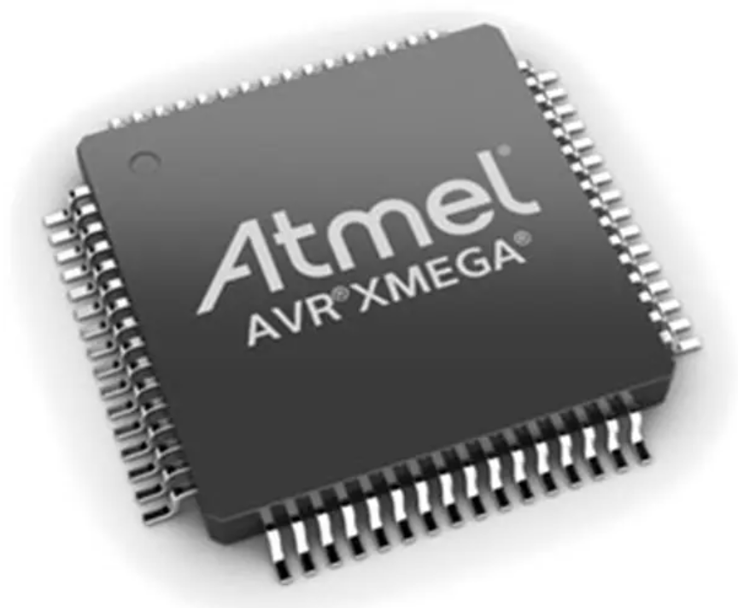
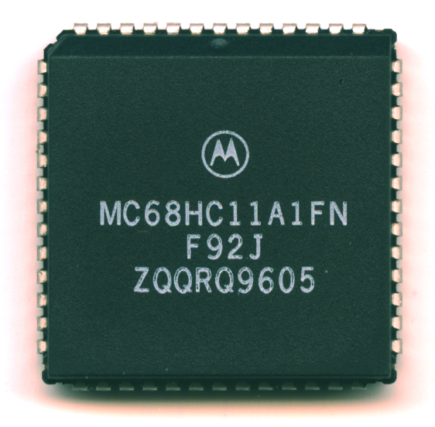
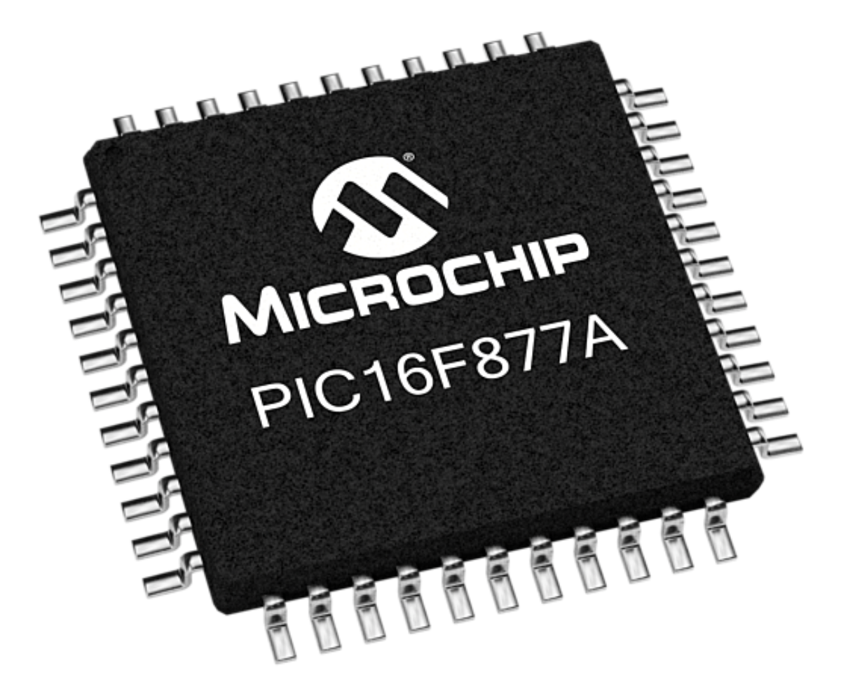
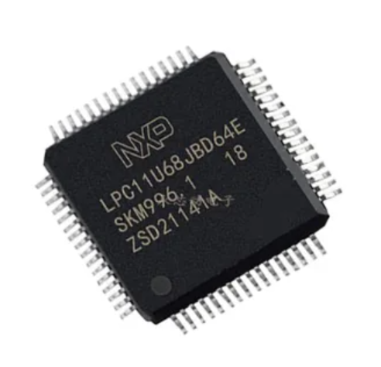
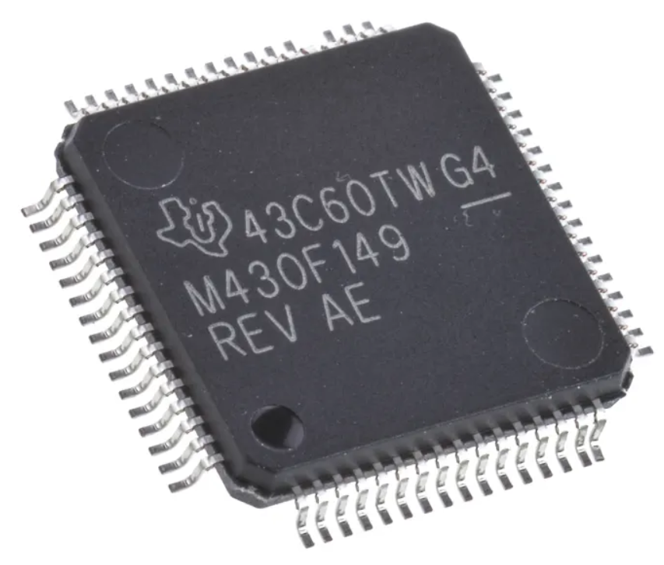
Design With Microprocessors C1
Microchip
Atmel -> Microchip
Motorola
NXP, Philips
Texas Instruments
Source: web

Slide 4
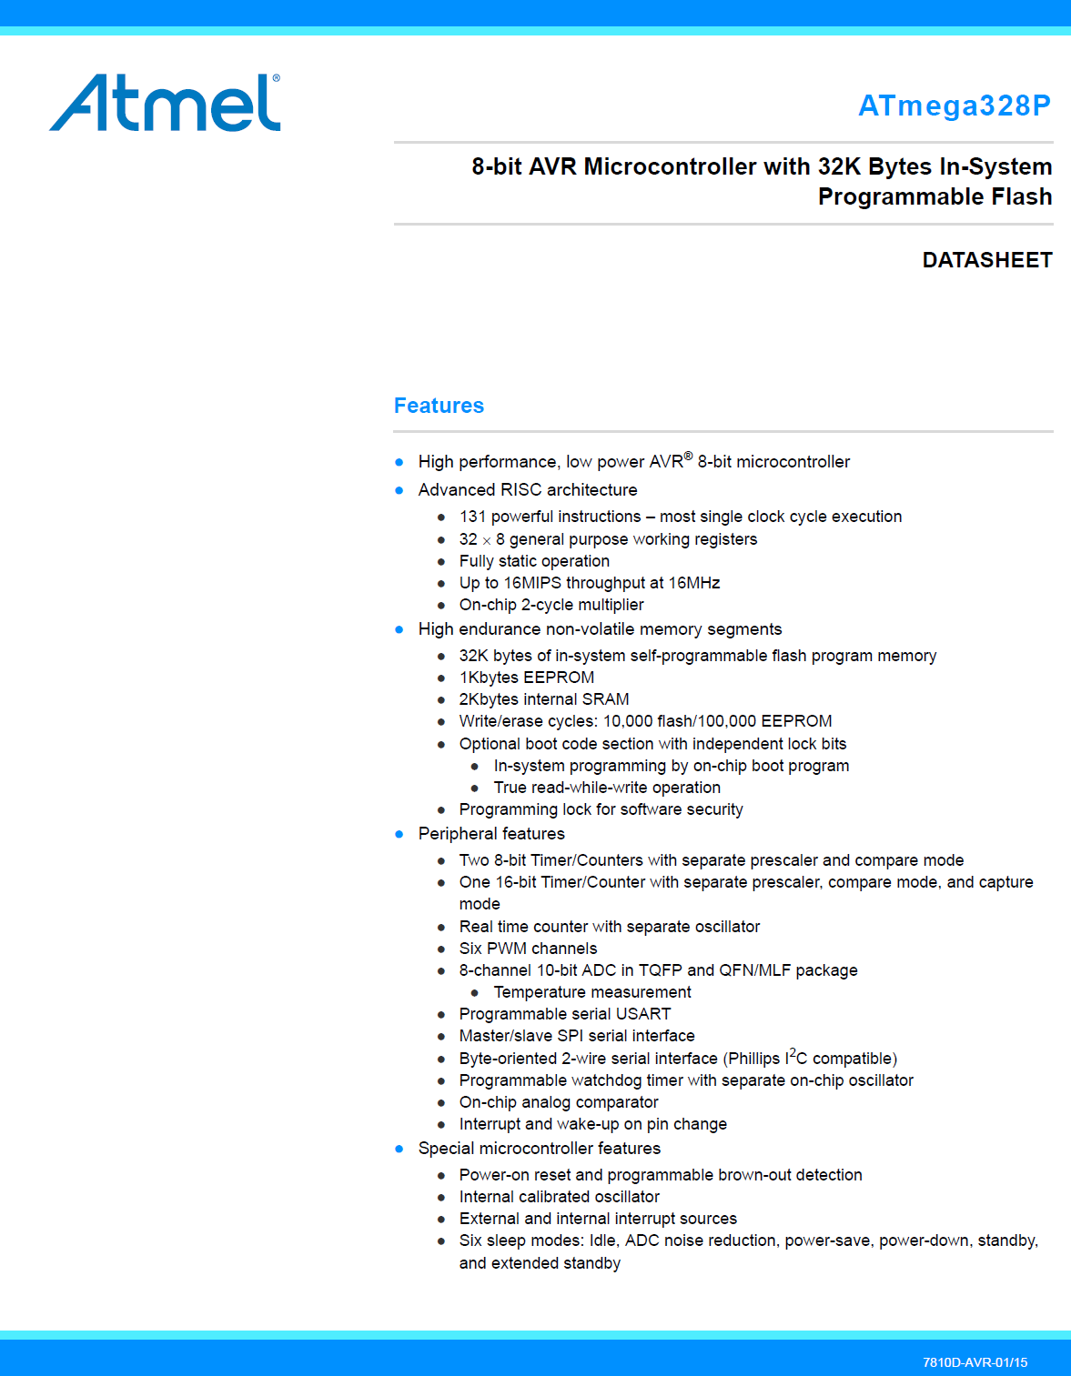
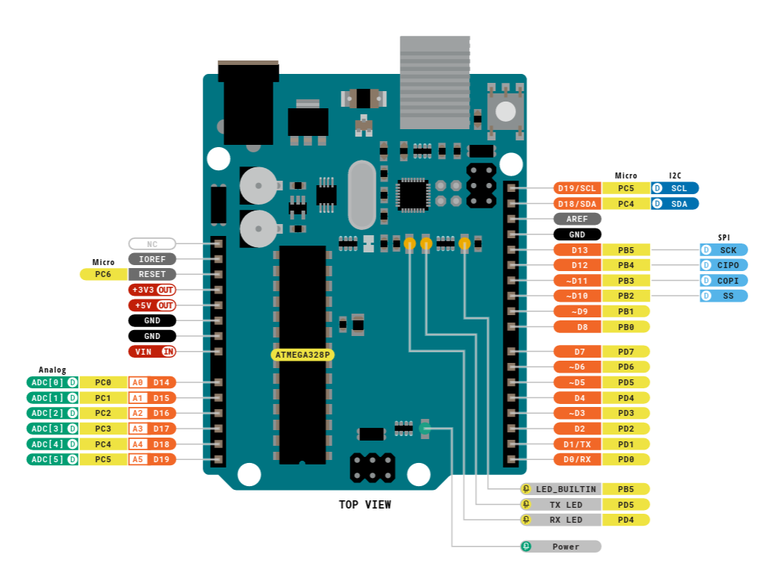
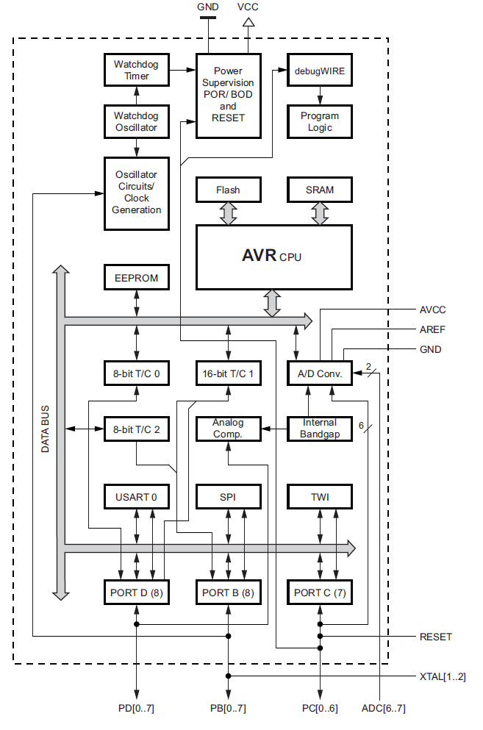
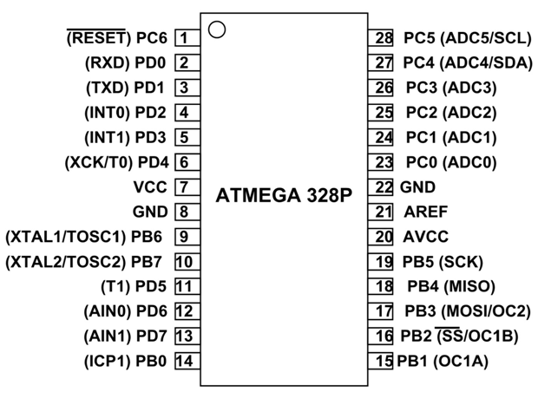
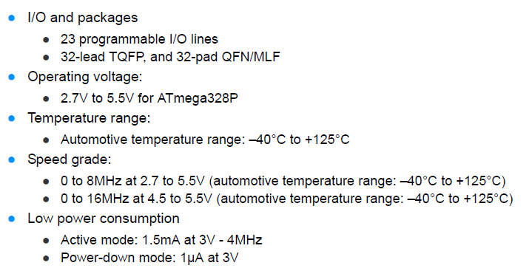
Design With Microprocessors C1
Source: web

Slide 5
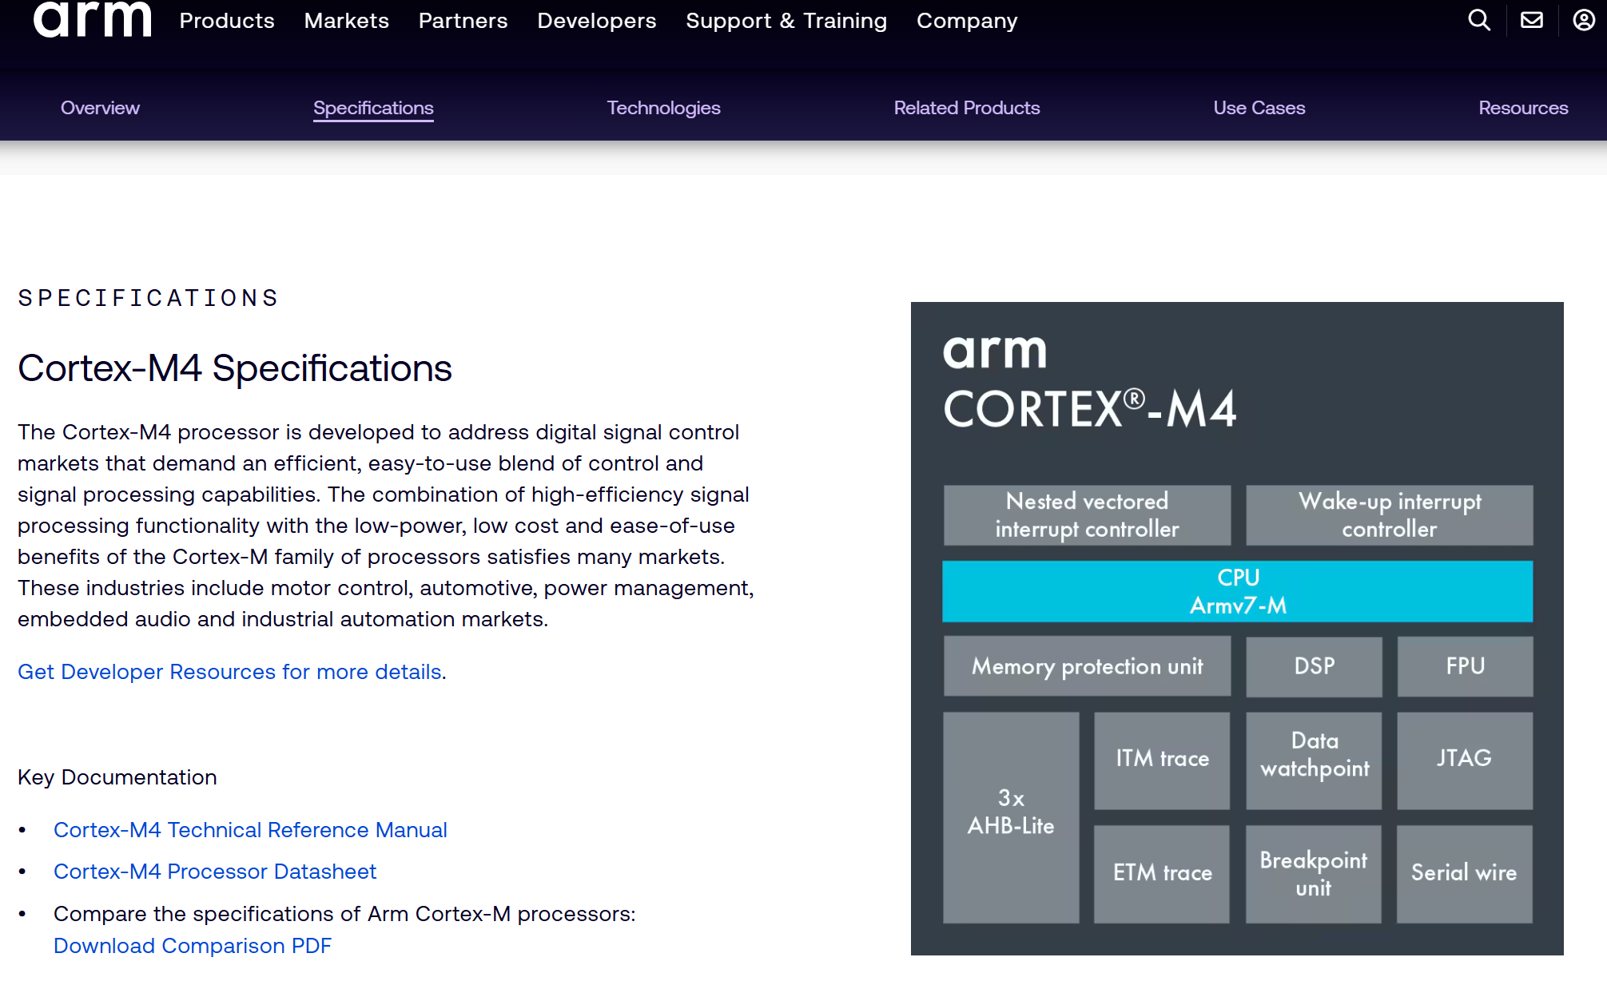
Design With Microprocessors C1
www.arm.com

Slide 6
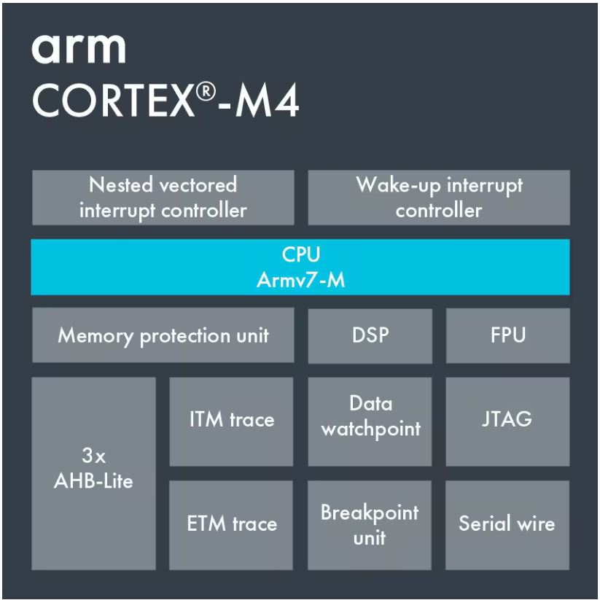
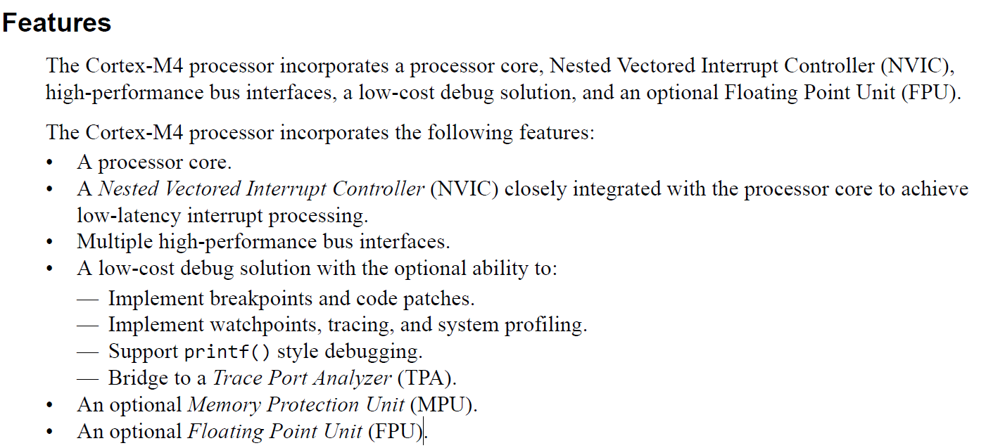
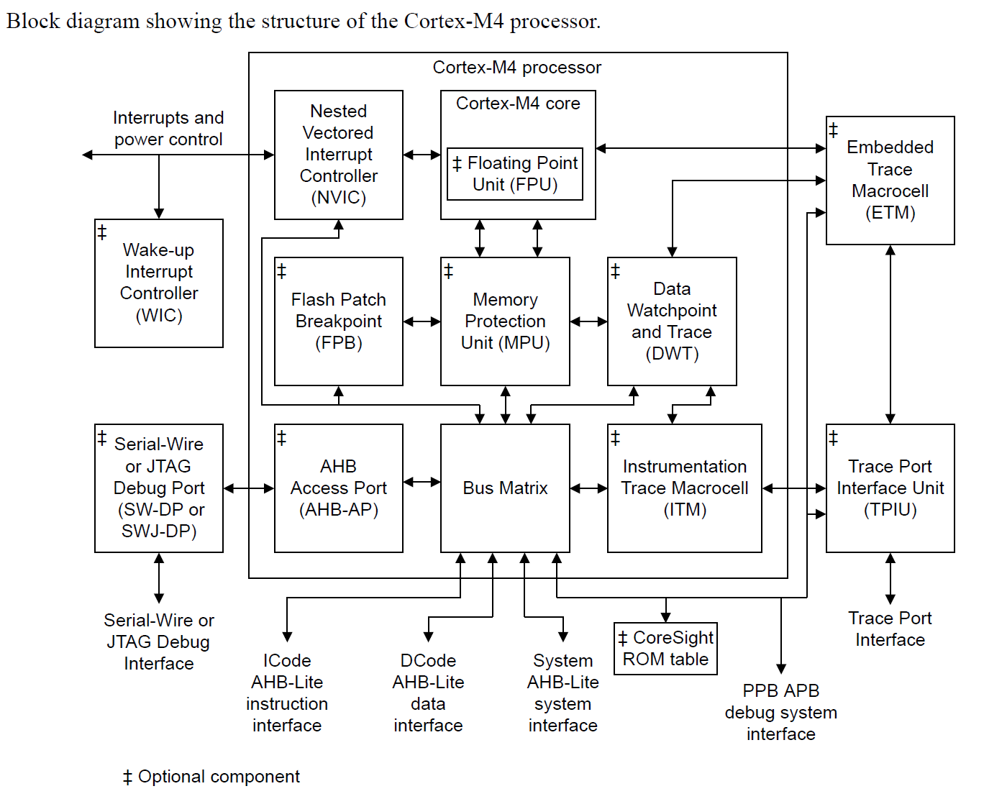
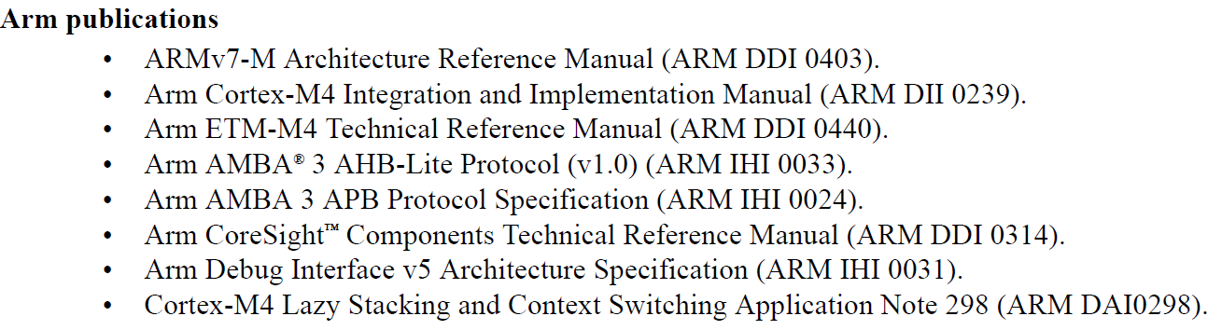
Design With Microprocessors C1
Arm® Cortex®-M4 Processor Technical Reference Manual

Slide 7
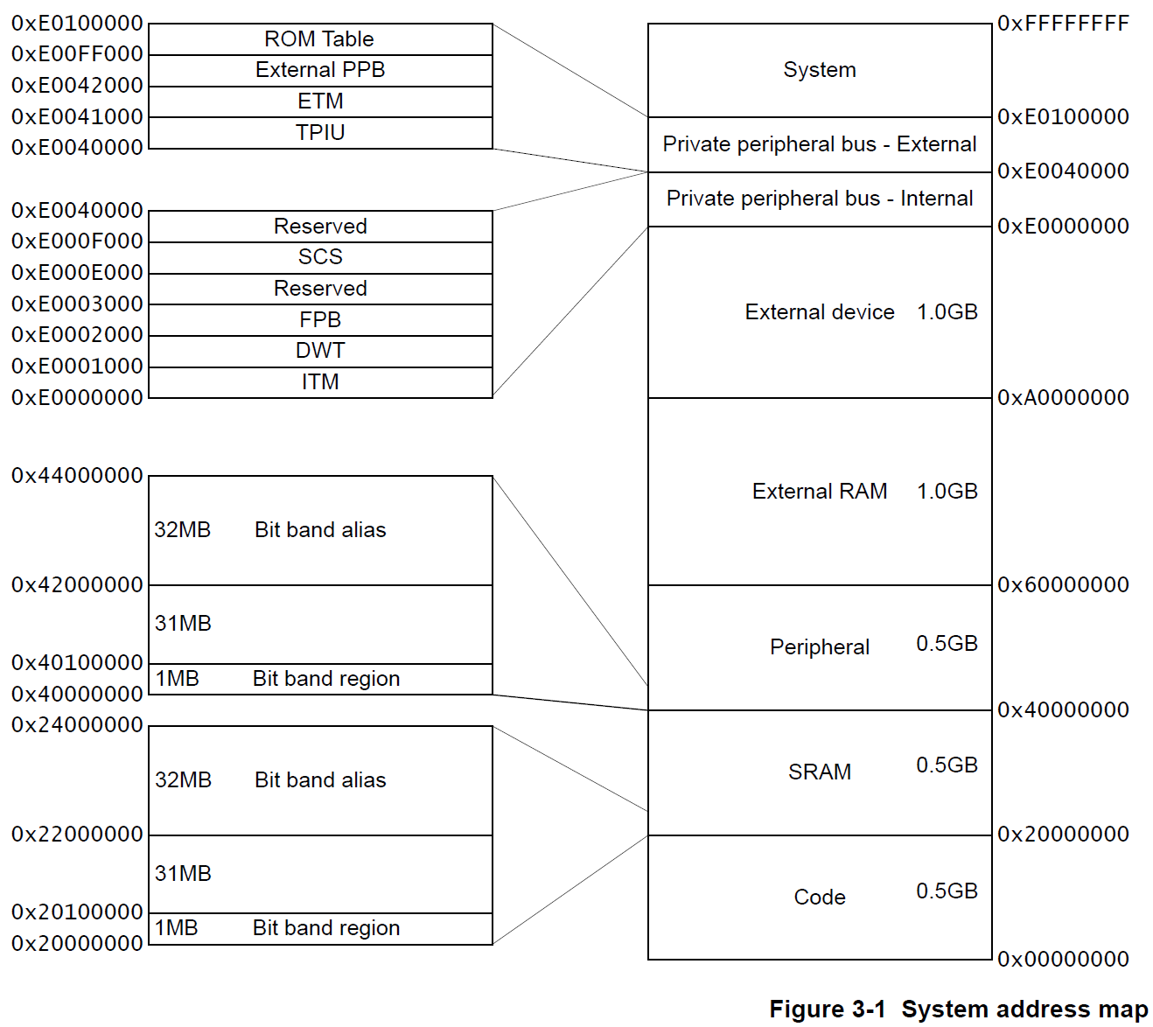
Design With Microprocessors C1
Arm® Cortex®-M4 Processor Technical Reference Manual

Slide 8

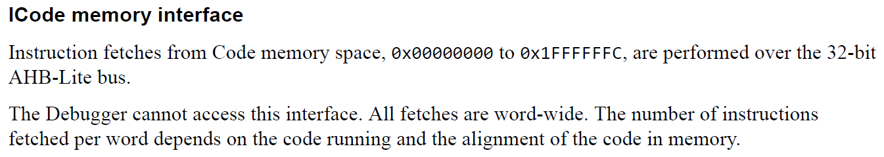
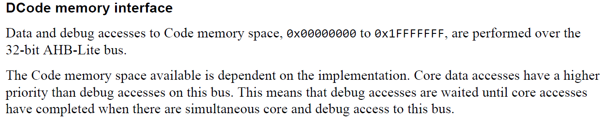
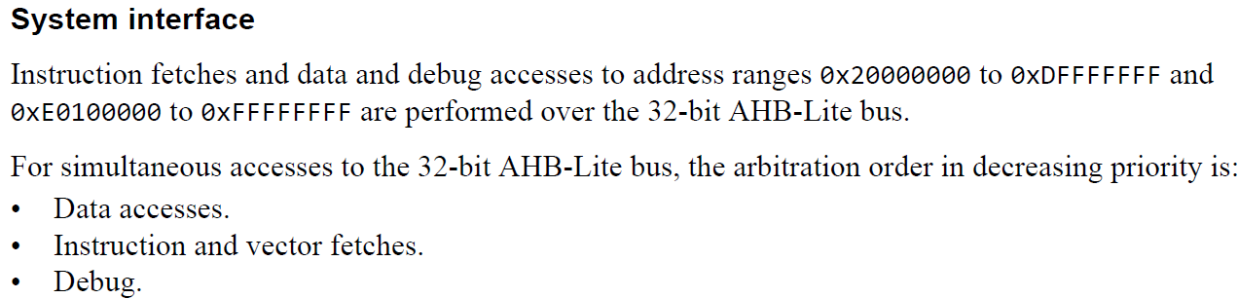
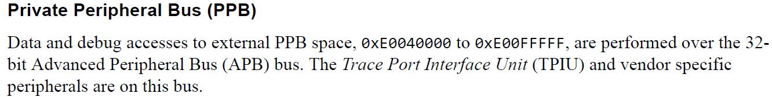
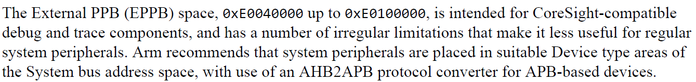
Design With Microprocessors C1
Arm® Cortex®-M4 Processor Technical Reference Manual

Slide 9
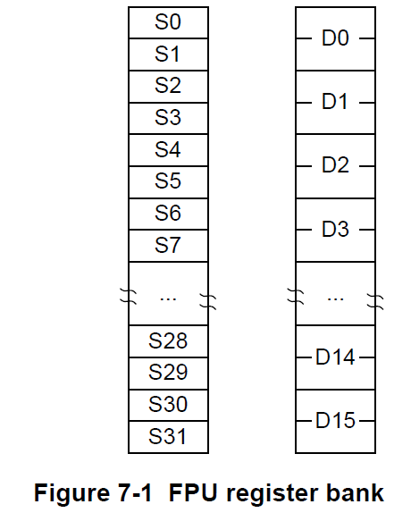
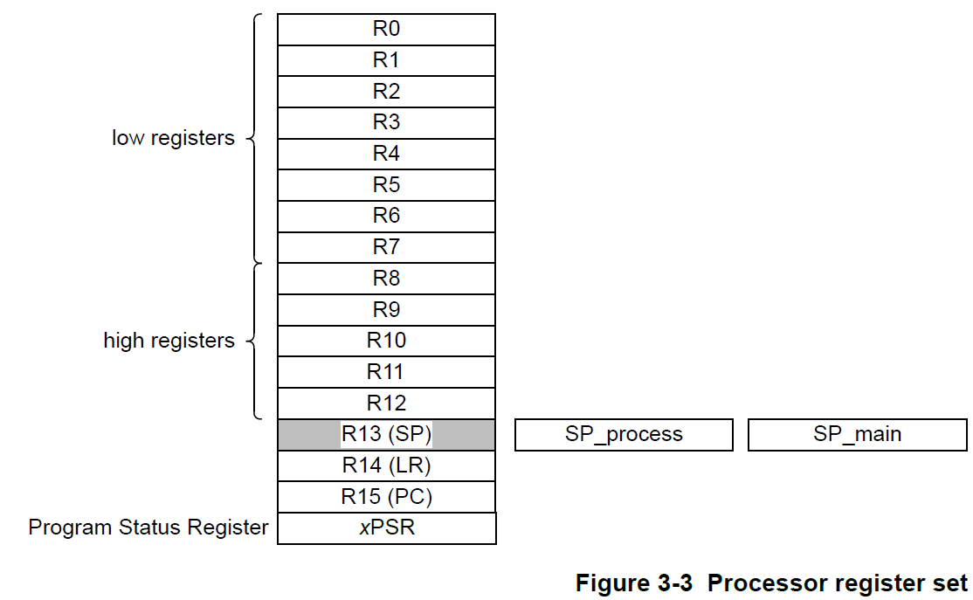
Design With Microprocessors C1
Arm® Cortex®-M4 Processor Technical Reference Manual
What is the address of the processor and the FPU registers ?

Slide 10
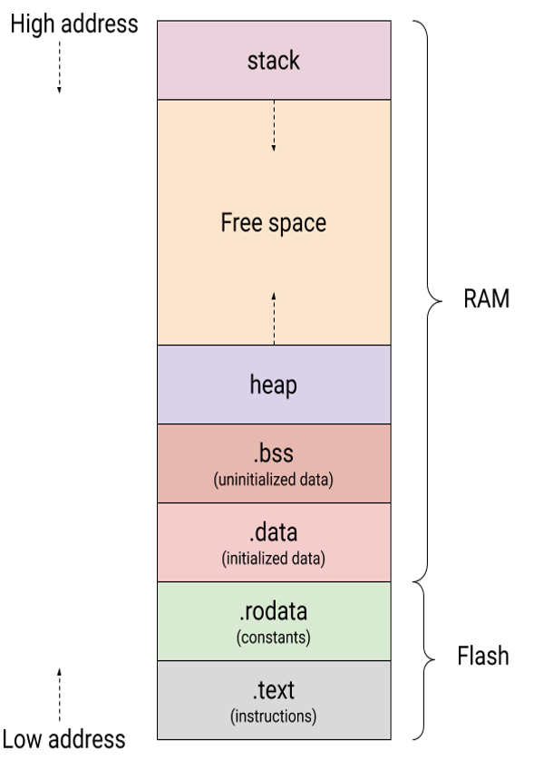
Design With Microprocessors C1
Arm® Cortex®-M4 Processor Technical Reference Manual

Slide 11
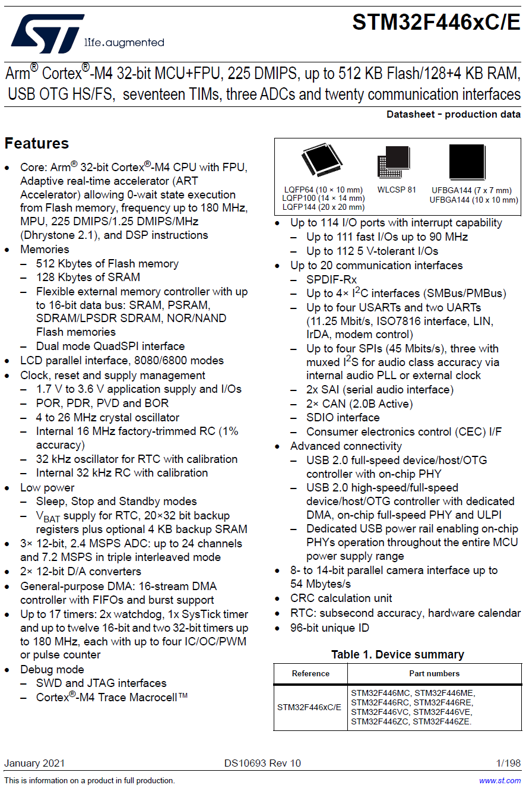
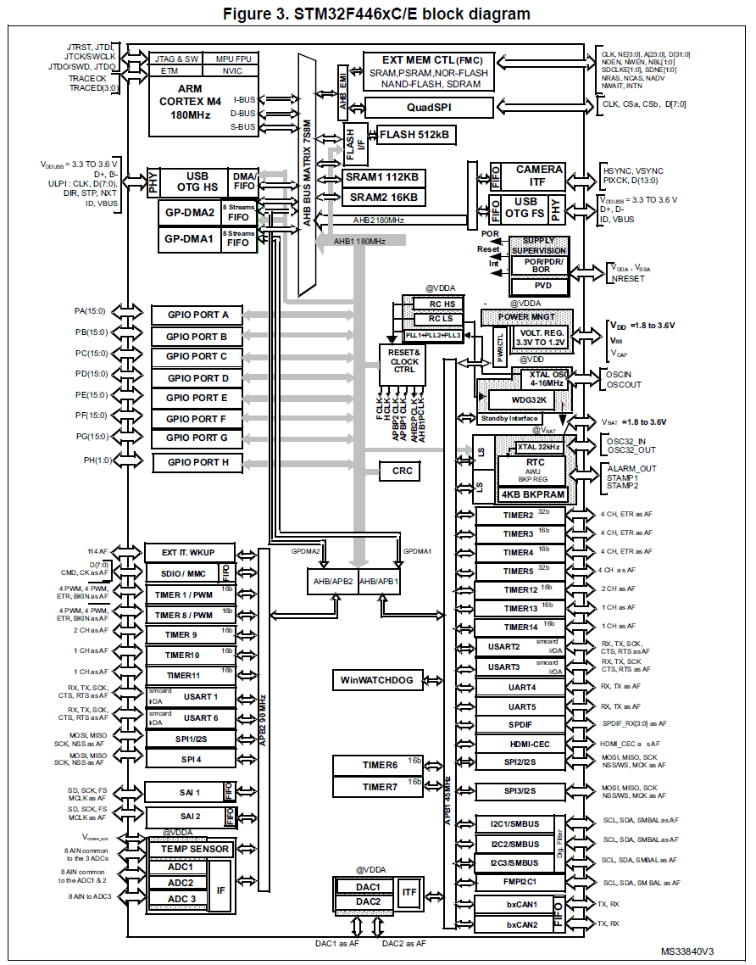
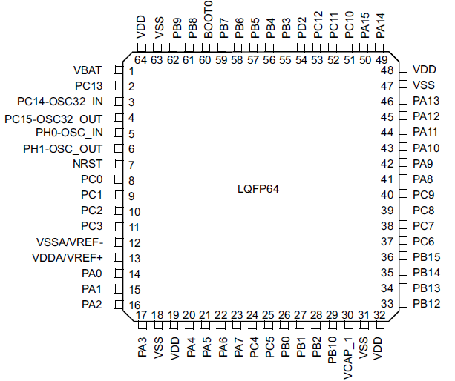
Design With Microprocessors C1
STM32F446xC/E

Slide 12
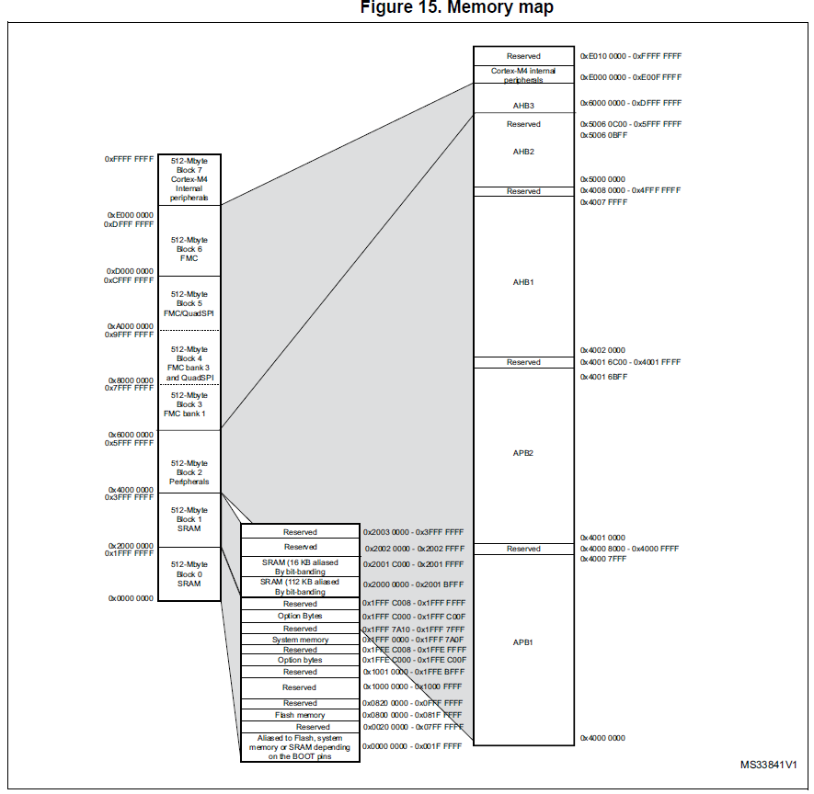
Design With Microprocessors C1
STM32F446xC/E
From the: STM32F446 Datasheet
From the: Arm® Cortex®-M4 Processor Technical Reference Manual

Slide 13
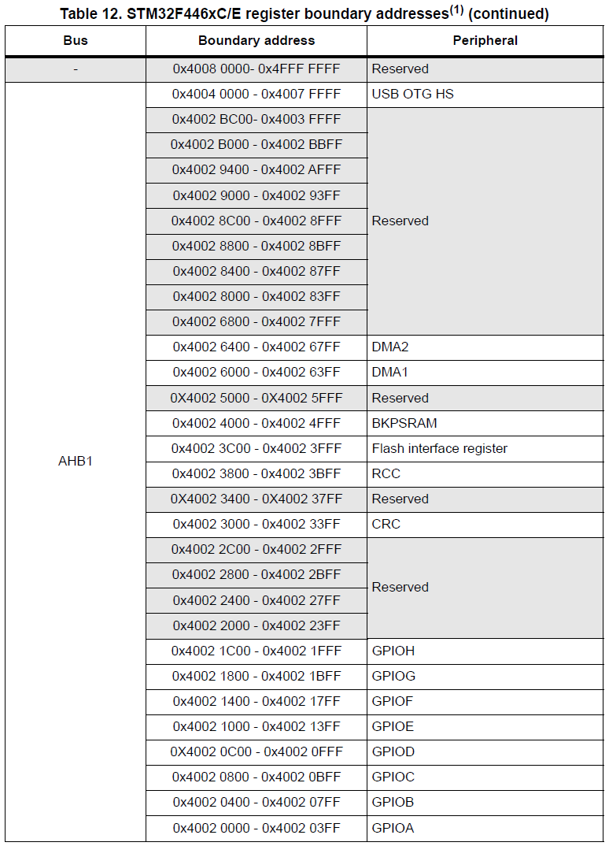
Design With Microprocessors C1
STM32F446xC/E
From the: STM32F446 Datasheet

Slide 14
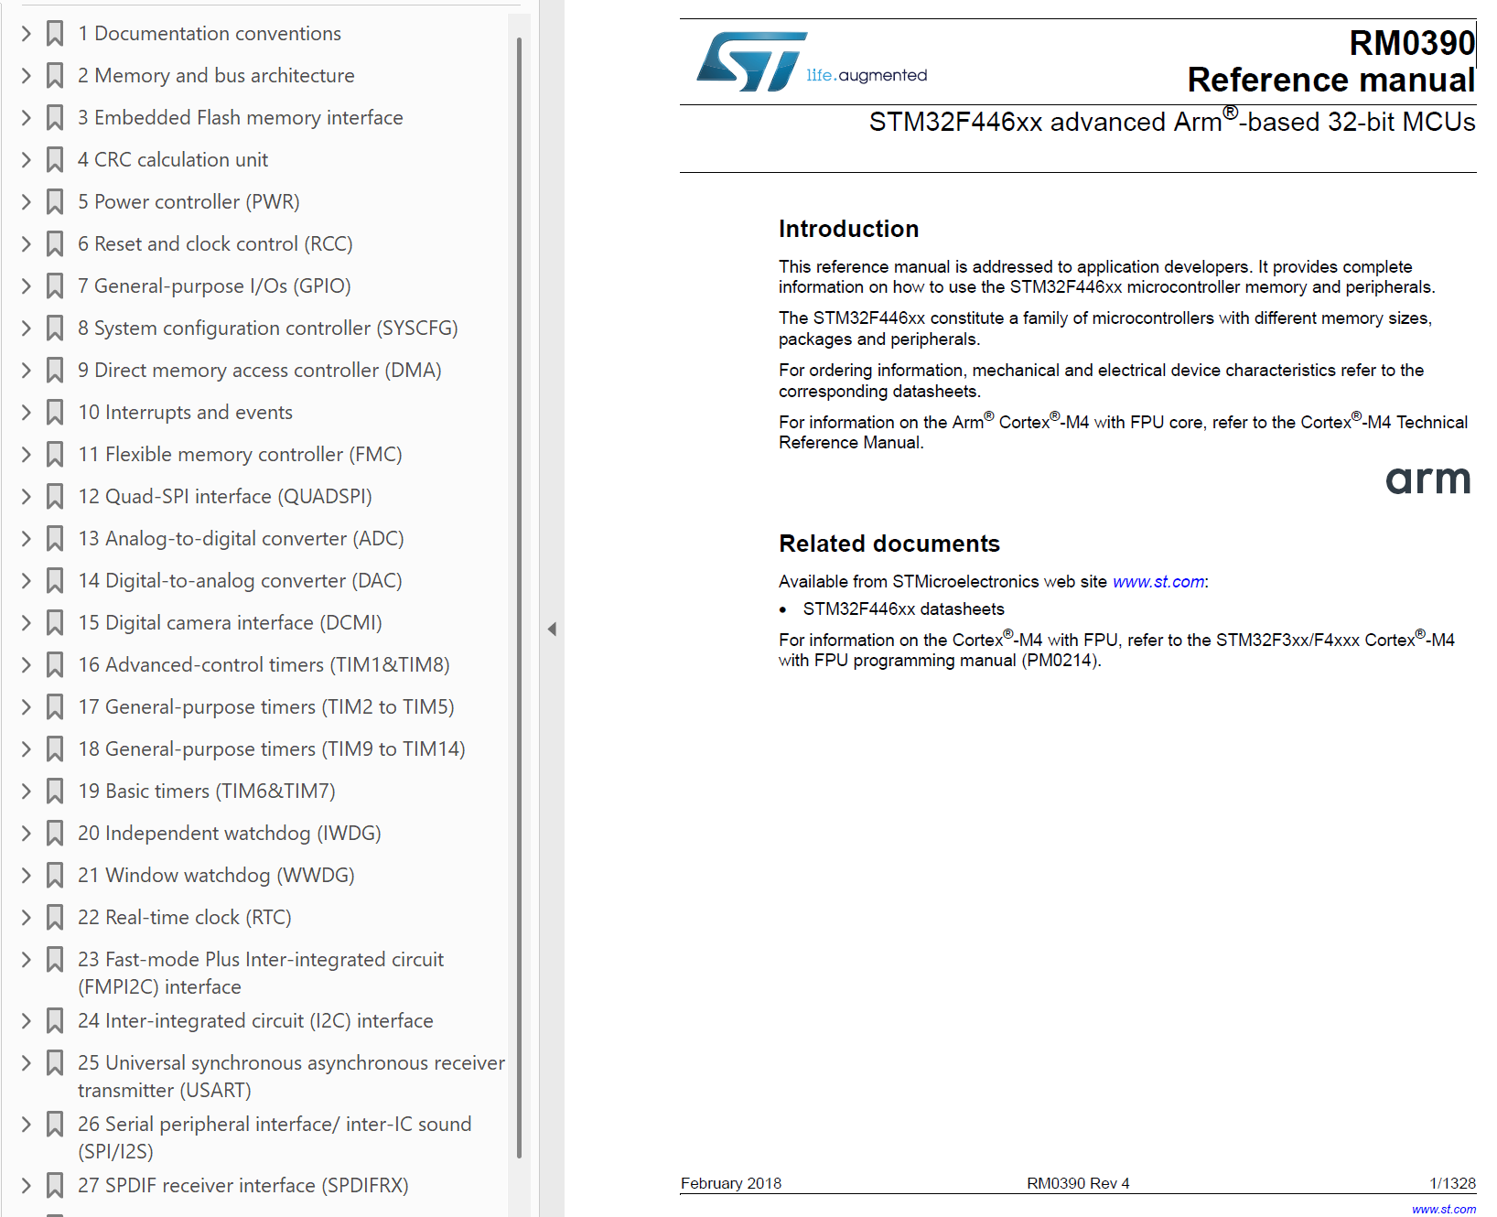
Design With Microprocessors C1
STM32F446x RM0390 Reference manual

Slide 15
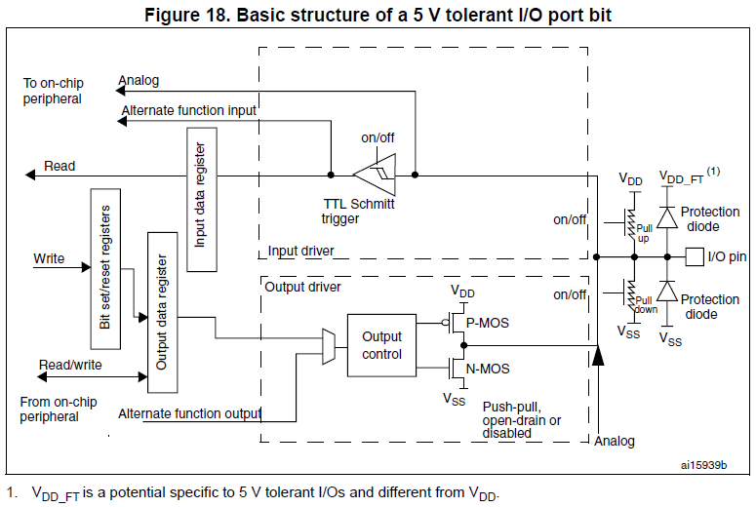
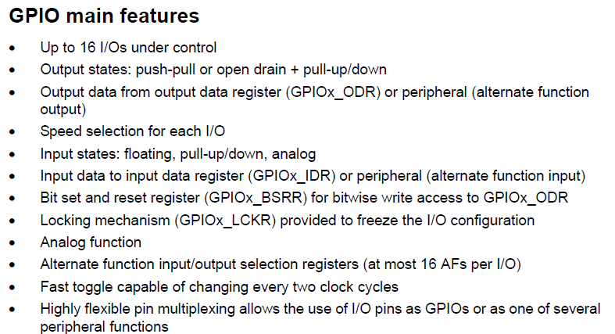
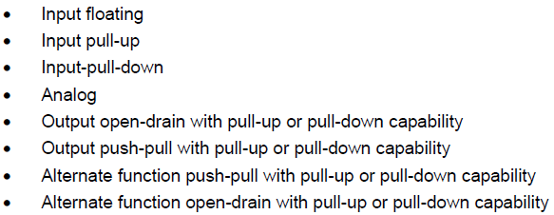
Design With Microprocessors C1
STM32F446x RM0390 Reference manual
General-purpose I/Os (GPIO)

Slide 16
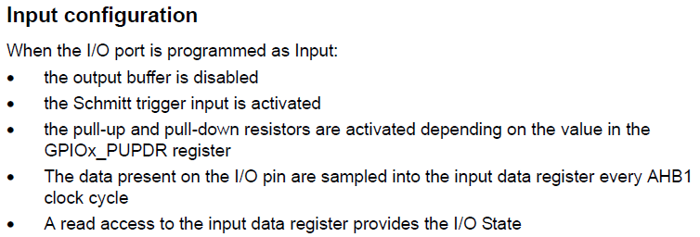
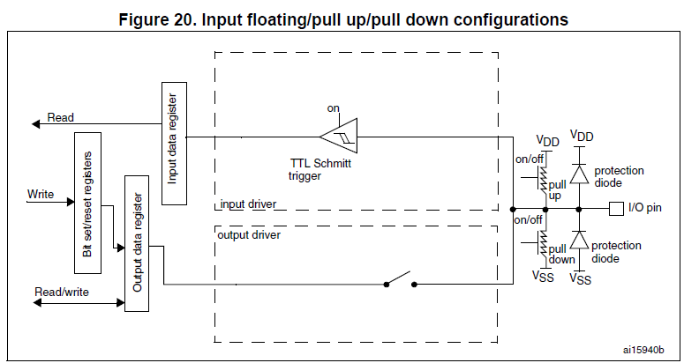
Design With Microprocessors C1
STM32F446x RM0390 Reference manual
General-purpose I/Os (GPIO)

Slide 17
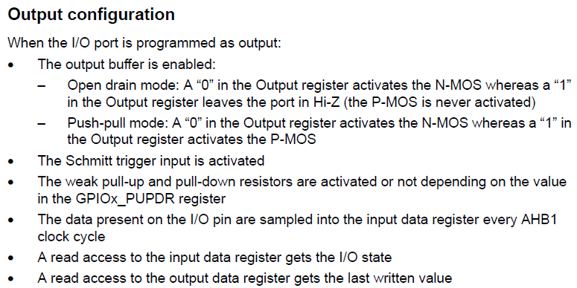
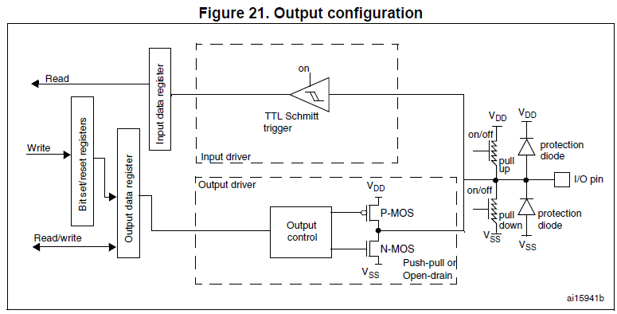
Design With Microprocessors C1
STM32F446x RM0390 Reference manual
General-purpose I/Os (GPIO)

Slide 18
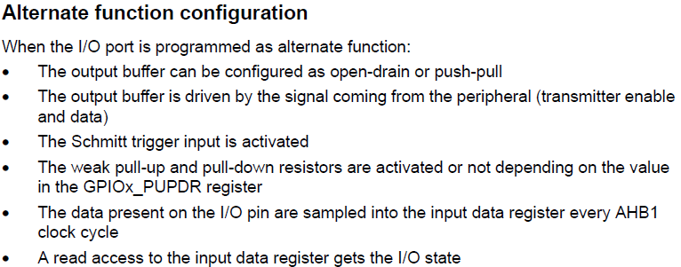
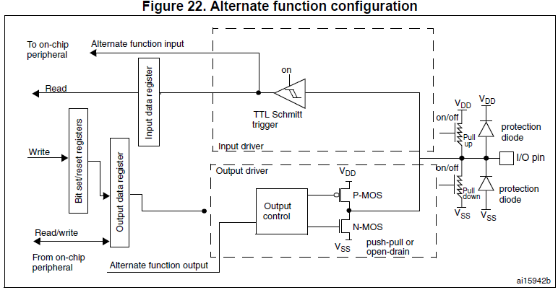
Design With Microprocessors C1
STM32F446x RM0390 Reference manual
General-purpose I/Os (GPIO)

Slide 19
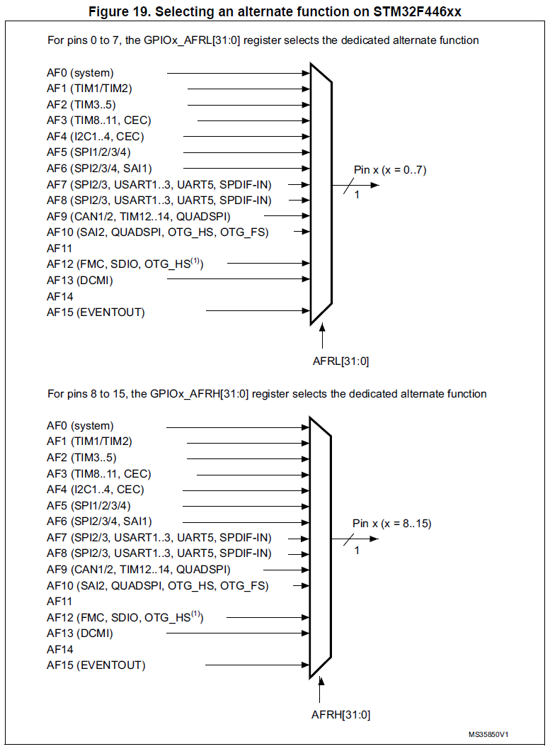
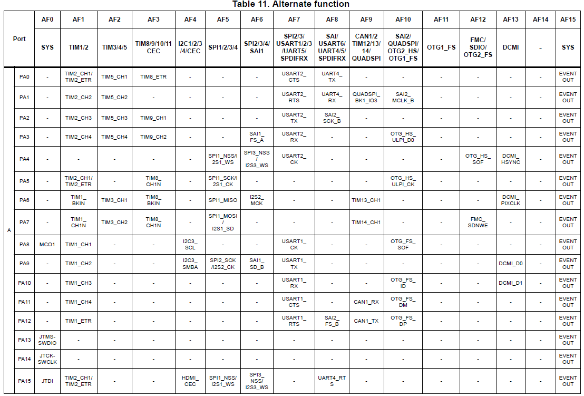
Design With Microprocessors C1
STM32F446x RM0390 Reference manual
General-purpose I/Os (GPIO)
From the: STM32F446 Datasheet

Slide 20
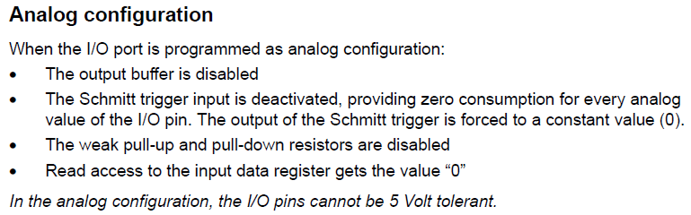
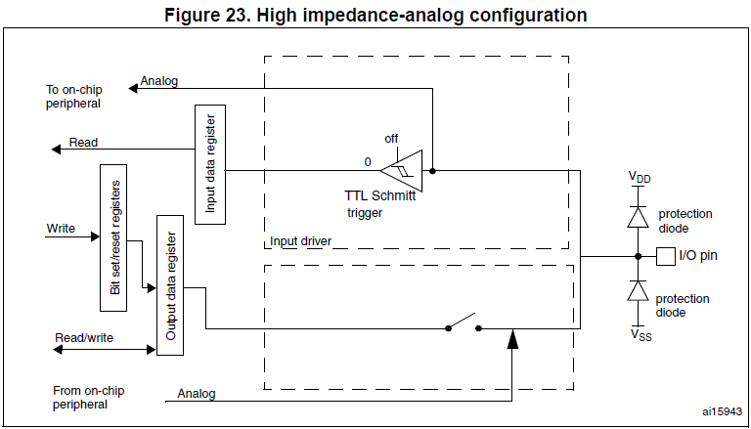
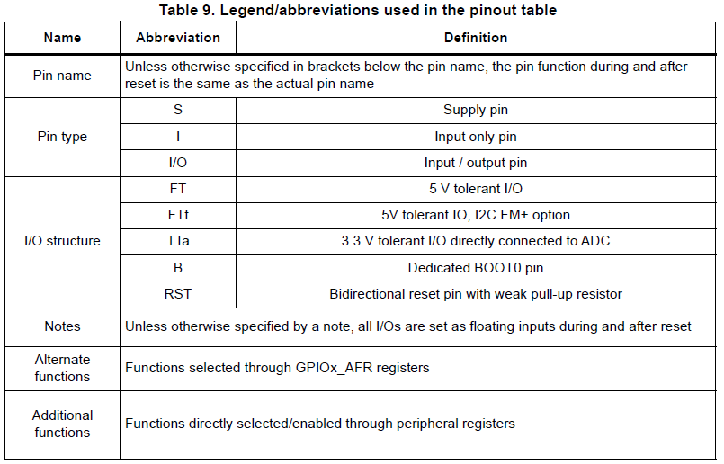
Design With Microprocessors C1
STM32F446x RM0390 Reference manual
General-purpose I/Os (GPIO)
From the: STM32F446 Datasheet

Slide 21
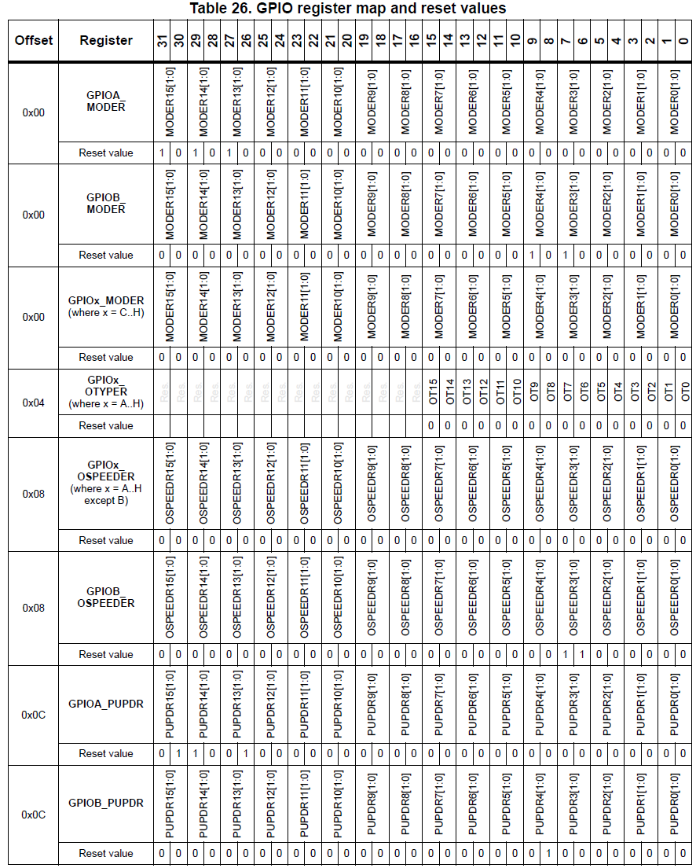

Design With Microprocessors C1
STM32F446x RM0390 Reference manual
General-purpose I/Os (GPIO)

Slide 22



Design With Microprocessors C1
STM32F446x -> NUCLEO-F446RE

Slide 23
Design With Microprocessors C1

